Slide 1

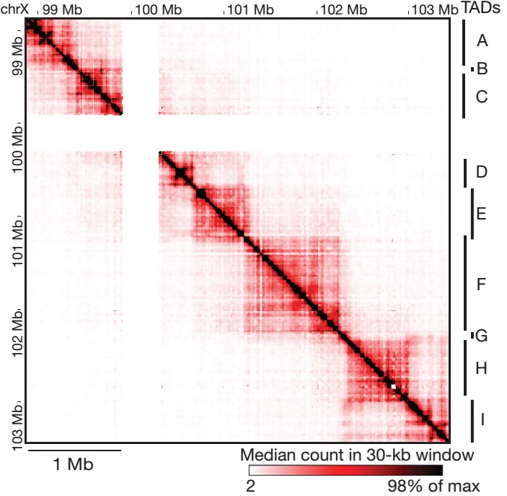
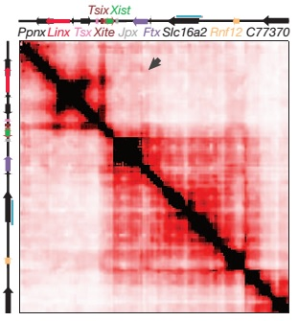
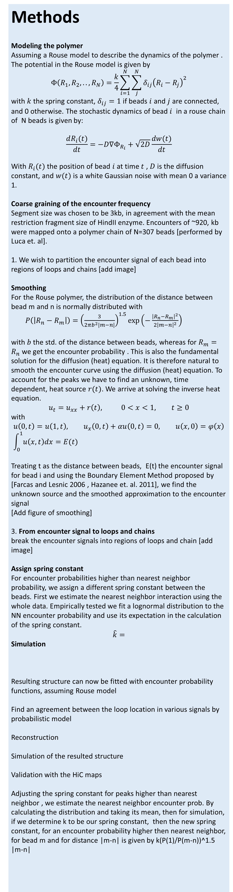
Reconstruction of the X-inactivation center structure using HiC encounter frequency maps
Ofir Shukron, David Holcman,
Departement de Biologie, Ecole Normale Superieure, 46 rue d’Ulm, 75005, Paris, France
Goal Reconstruct the local polymer architecture using HiC encounter frequency maps; Study the dynamic properties of the resulting structure, such as the encounter time distribution and Mean First encounter time (MFET) between different parts of a polymer.
Significance Providing a tool to transform static HiC encounter map to an average polymer structure, which captures salient features in the chromosome microstructure, allowing analysis and simulation of the dynamics of a cross-linked polymer in various scenarios.
Background:
HiC experiment simultaneously captures millions of looping events of the chromosome. HiC steps include 1. extraction of loci from cells, 2. fixation using formaldehyde 3. digestion using restriction enzymes, e.g. HindIII, 4. ligation, 5. reverse cross linking 6. mapping using PCR
Analysis of the HiC experiment in mouse embryonic stem cells reveals the presence of stable Topologically Associating Domains (TAD) , in the 4.5Mb region of the X inactivation center, however the actual architecture in a specific stage is unknown
The data:
we use a subset of ~1Mb region of the X-chromosome around the X- inactivation center , provided by G.Luca et. Al.
Methods
Modeling the polymer
Assuming a Rouse model to describe the dynamics of the polymer . The potential in the Rouse model is given by $$Φ\left(R_{1},R_{2},..,R_{N}\right)=\frac{k}{4}\sum_{i=1}^{N}{\sum_{j}^{N}{{δ_{ij}\left(R_{i}−R_{j}\right)}^{2}}}$$ with $k$ the spring constant, $δ_{ij}=1$ if beads $i$ and $j$ are connected, and 0 otherwise. The stochastic dynamics of bead $i$ in a rouse chain of N beads is given by:
$$\frac{dR_{i}(t)}{dt}=−D∇Φ_{R_{i}}+\sqrt{2D}\frac{dw(t)}{dt}$$
With $R_{i}(t)$ the position of bead $i$ at time $t$ , $D$ is the diffusion constant, and $w(t)$ is a white Gaussian noise with mean 0 a variance 1.
Coarse graining of the encounter frequency Segment size was chosen to be 3kb, in agreement with the mean restriction fragment size of HindII enzyme. Encounters of ~920, kb were mapped onto a polymer chain of N=307 beads [performed by Luca et. al].
1. We wish to partition the encounter signal of each bead into regions of loops and chains [add image]
Smoothing For the Rouse polymer, the distribution of the distance between bead m and n is normally distributed with $P\left(\left|R_{n}−R_{m}\right|\right)={\left(\frac{3}{2πb^{2}|m−n|}\right)}^{1.5}exp⁡\left(−\frac{{\left|R_{n}−R_{m}\right|}^{2}}{2{\left|m−n\right|}^{2}}\right)$ with $b$the std. of the distance between beads, whereas for $R_{m}=R_{n}$ we get the encounter probability . This is also the fundamental solution for the diffusion (heat) equation. It is therefore natural to smooth the encounter curve using the diffusion (heat) equation. To account for the peaks we have to find an unknown, time dependent, heat source $r(t)$. We arrive at solving the inverse heat equation.
$$u_{t}=u_{xx}+r\left(t\right), 0<x<1, t≥0$$
with
$$u\left(0,t\right)=u\left(1,t\right), u_{x}\left(0,t\right)+αu\left(0,t\right)=0, u\left(x,0\right)=φ\left(x\right) \\ \int_{0}^{1}{u\left(x,t\right)dx=E(t)}$$
Treating t as the distance between beads, E(t) the encounter signal for bead i and using the Boundary Element Method proposed by [Farcas and Lesnic 2006 , Hazanee et. al. 2011], we find the unknown source and the smoothed approximation to the encounter signal
[Add figure of smoothing]
3. From encounter signal to loops and chains
break the encounter signals into regions of loops and chain [add image]
Assign spring constant
For encounter probabilities higher than nearest neighbor probability, we assign a different spring constant between the beads. First we estimate the nearest neighbor interaction using the whole data. Empirically tested we fit a lognormal distribution to the NN encounter probability and use its expectation in the calculation of the spring constant. $$\hat{k}=$$ Simulation
Resulting structure can now be fitted with encounter probability functions, assuming Rouse model
Find an agreement between the loop location in various signals by probabilistic model
Reconstruction
Simulation of the resulted structure
Validation with the HiC maps
Adjusting the spring constant for peaks higher than nearest neighbor , we estimate the nearest neighbor encounter prob. By calculating the distribution and taking its mean, then for simulation, if we determine k to be our spring constant, then the new spring constant, for an encounter probability higher then nearest neighbor, for bead m and for distance |m-n| is given by k(P(1)/P(m-n))^1.5 |m-n|
Results:
In synthetic example, we see accurate reconstruction.
Nora et. Al 2012

